Slide 1
Artificial Synthesis of Sound Tracks for Silent Videos
Swaraj P. Dash (1701209365)
B.Tech (CSE), 7th sem
Silicon Institute of Technology

Slide 2
What Is A Foley Studio?
Foley is the reproduction of everyday sound effects that are added to films, videos, and other media in post-production to enhance audio quality.

Slide 3
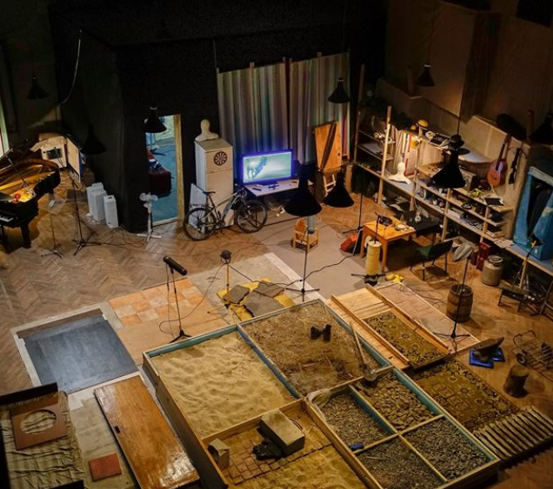
The Foley Studio

Slide 4
Why AutoFoley?
The process of Foley sound synthesis adds significant time and cost to the creation of a motion picture.

Slide 5


1. Methodology
Feature Extraction
Class Prediction
Approach 1
Approach 2
Sound Synthesis

Slide 6
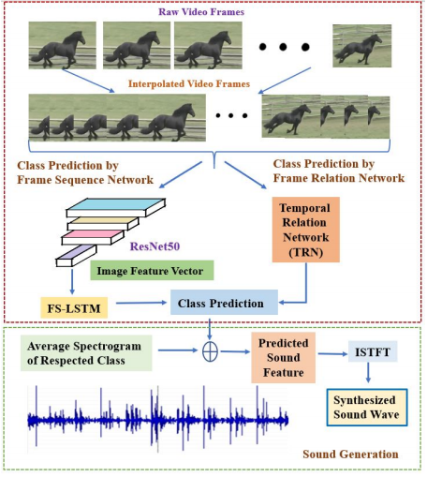
Sound Feature Extraction
Spectrogram Analysis: a visual way of representing the strength of a signal over time.

Slide 7
Building the Models
Video Preprocessing
Class Prediction
Applying CNNs
To prepare video data for training
Finding the categories of the different sounds
Approach 1: Frame Sequence Network
Computing Image Feature Vectors

Slide 8
Video Preprocessing using Interpolation
Audio frames are 13x Video frames
Equalization needed for proper mapping
Replication fails to store precise information
Interpolation algorithm used to generate intermediate video frames

Slide 9
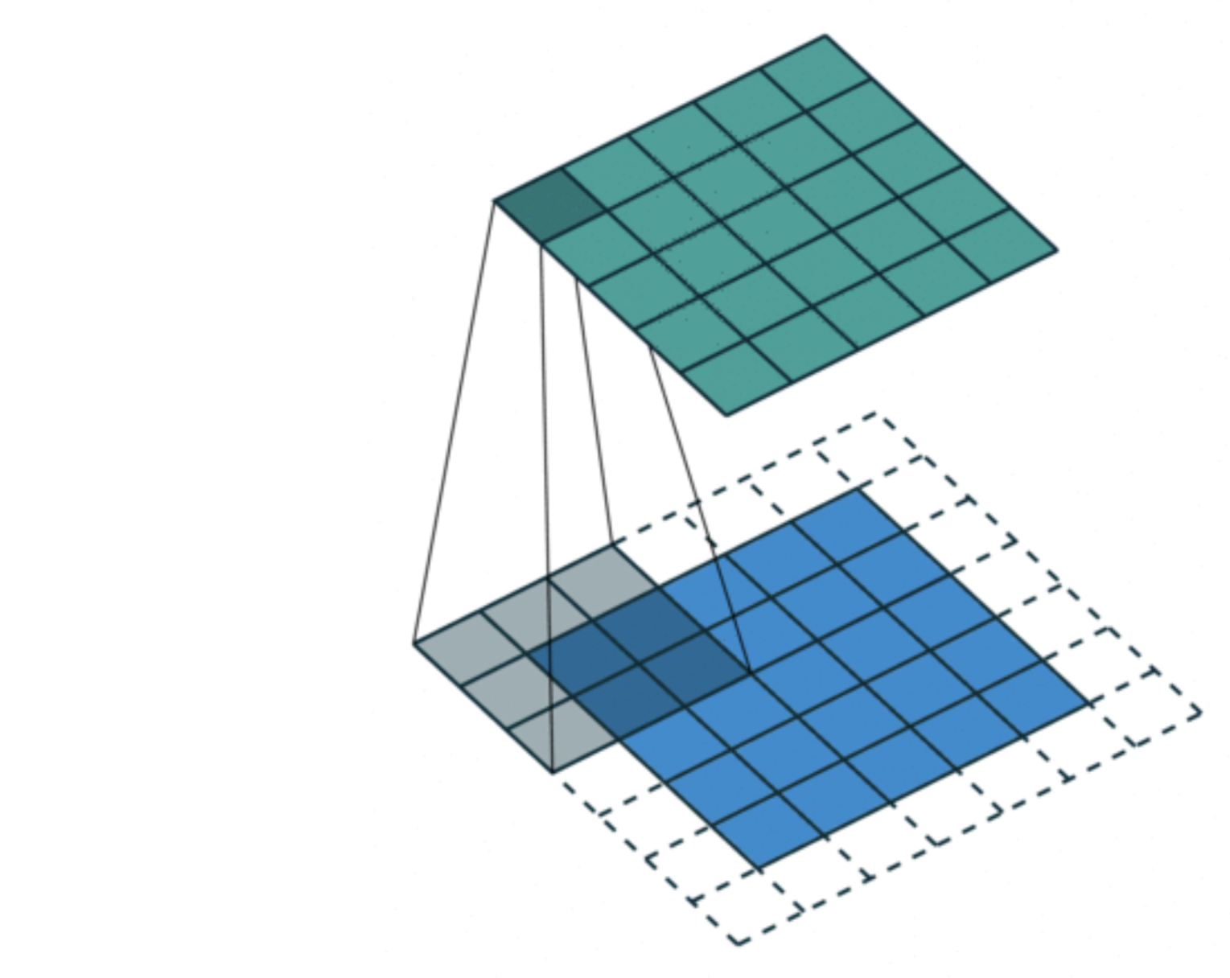
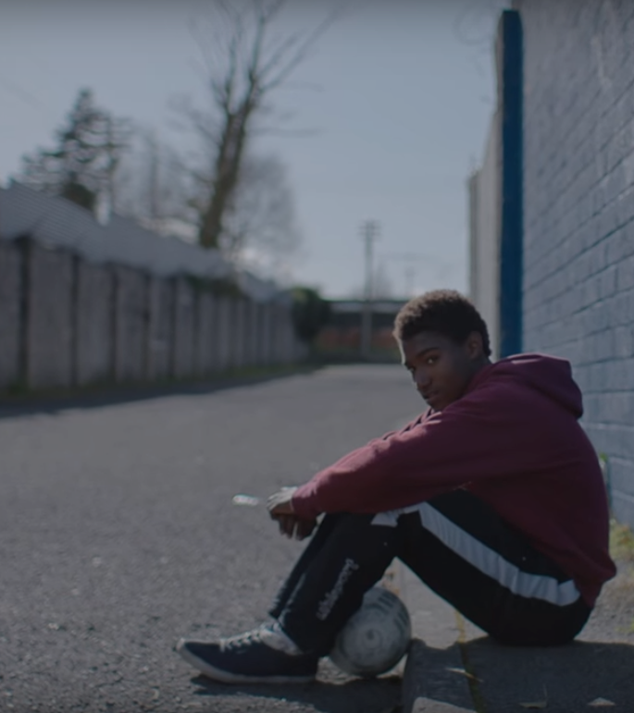
Convolutional Neural Network
A Convolutional Neural Network (ConvNet/CNN) is a DL algorithm which takes in an input image, assign importance to various aspects in the image and be able to differentiate them.

Slide 10
Generate Image Vector using CNNs
Compute with ResNet-50
Space-time images are formed for each frame by joining 3 grayscaled images of previous, current and next frame
Input feature vector for each frame is computed by concatenating CNN features for the spacetime image and the RGB image from the first frame of each video

Slide 11
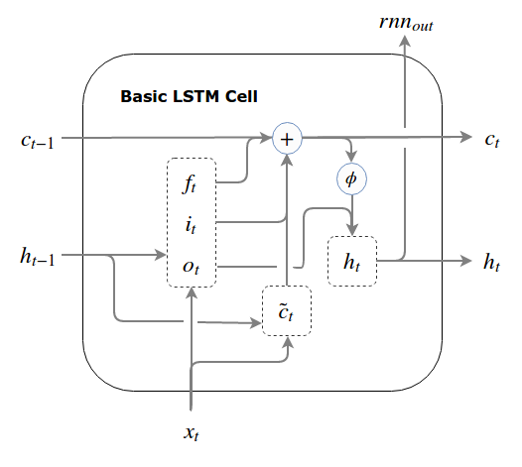
LSTMs
Long short-term memory is an artificial RNN architecture used in DL. Unlike standard feedforward NNs, LSTM has feedback connections.

Slide 12
Sound Class Prediction using FS-LSTM
Image features obtained are used as input
LSTM cells map video to audio frames
They predict the sound features form the visual input

Slide 13
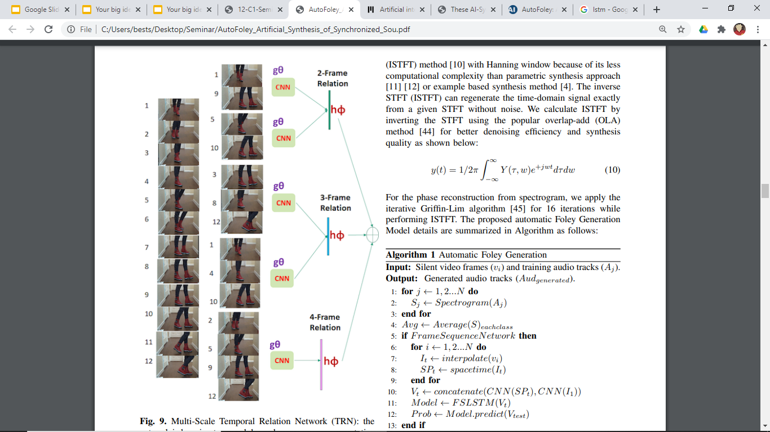
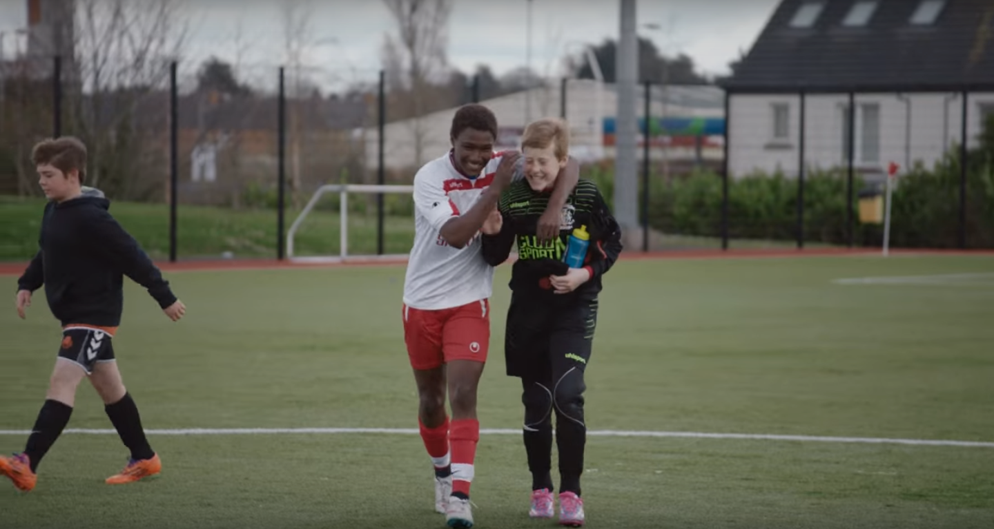
Approach 2: Frame-Relation Network
To capture the detail transformations and actions of the objects more accurately with less computation time. To learn the model about the complex behaviors of a scene with less amount of video frames, we apply an interpretable network combining CNN and MultiScale Temporal Relation Network (TRN)

Slide 14
Sound Synthesis
Same approach used on both the sound class prediction approaches
The Iterative Griffin-Lim algorithm is applied while performing ISTFT
Check results at "https://rb.gy/gh4afm”

Slide 15
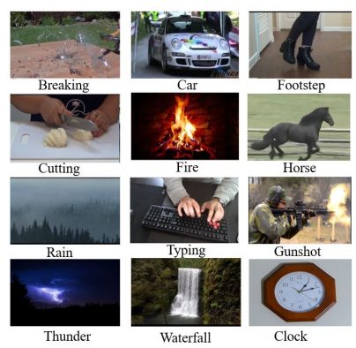
The Automatic Foley Dataset (AFD)
We select 12 different categories of videos (that are frequently used for Foley generation) like cutting, footsteps, car passing, clock sound, breaking, gunshots, horse running, waterfall, etc.

Slide 16
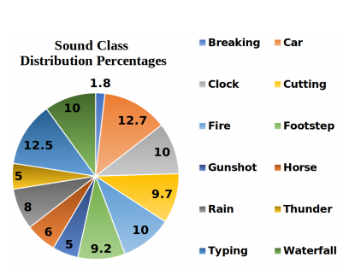
Implementation
Audio sampling rate of 44 kHz and video frame rate of 190 FPS
Two 2048-D image feature vectors obtained
Minibatch size of 128 and learning rate of 0.001

Slide 17
Evaluation
Qualitative Evaluation
Spectogram Analysis
Sound Quality Matrix
Quantitative Evaluation
Sound Class Prediction
Accuracy Calculation
Human Evaluation
...

Slide 18
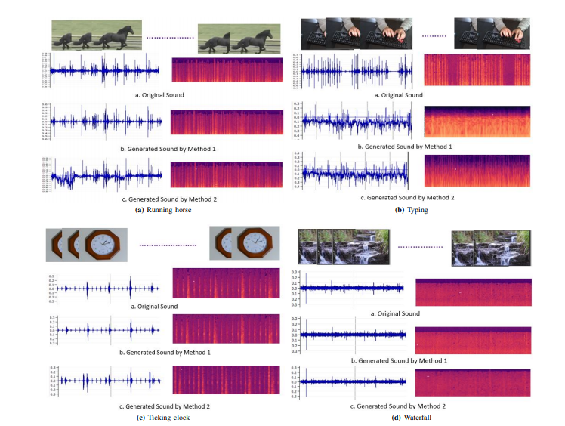

Slide 19
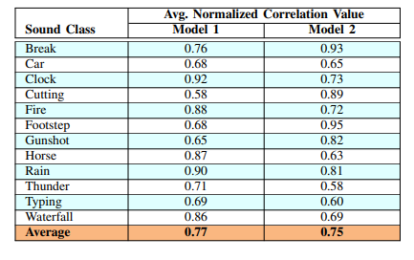
Quantitative Analysis
For each sound category, average normalized cross correlation values are calculated between generated and original audio signals to know how much similarity exists between them

Slide 20
3. Human Evaluation
People were asked to:
Select the original (more realistic) sample.
Select the most suitable sample (most reasonable audio initiated from the video clip).
Select the sample with minimum noise.
Select the most synchronized sample.

Slide 21
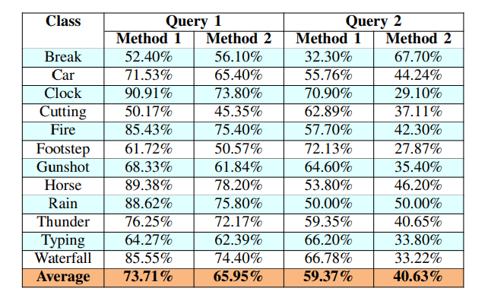
Analysis Results
For each sound category, average normalized cross correlation values are calculated between generated and original audio signals to know how much similarity exists between them

Slide 22
Thank You

